Slide 1

Agenda

Slide 2
Value at Risk (VAR)
VAR is the maximum loss over a target, horizon within a confidence interval (or, under normal market conditions)
In other words, if none of the “extreme events”(i.e., low-probability events) occurs, what is my maximum loss over a given time period?

Slide 3
Another Definition of VAR
•A forecast of a given percentile, usually in the lower tail, of the distribution of returns on a portfolio over some period; similar in principle to an estimate of the expected return on a portfolio, which is a forecast of the 50th percentile.
Ex: 95% one-tail normal distribution is 1.645 sigma (Pr(x<=X)=0.05, X=-1.645) while 99% normal distribution is 2.326 sigma

Slide 4
VAR: Example
•Consider a $100 million portfolio of medium-term bonds. Suppose my confidence interval is 95% (i.e., 95% of possible market events is defined as “normal”.) Then, what is the maximum monthly loss under normal markets over any month?
•To answer this question, let’s look at the monthly medium-term bond returns from 1953 to 1995:
•Lowest: -6.5% vs. Highest: 12%

Slide 5
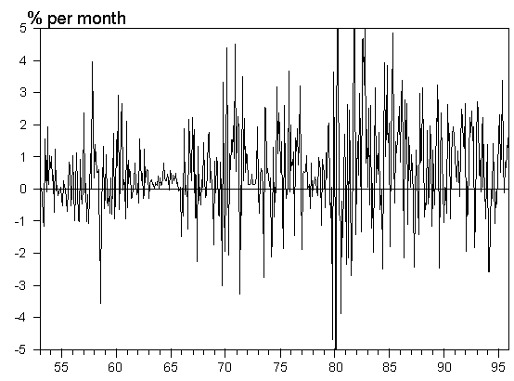
History of Medium Bond Returns

Slide 6
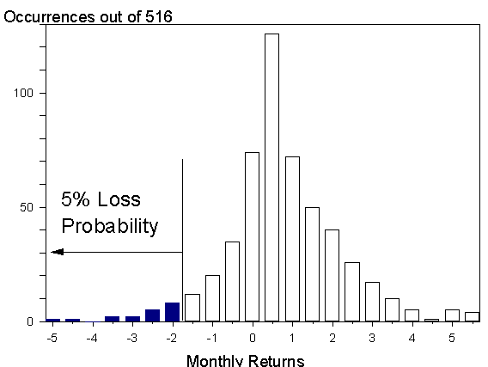
Distribution of
Medium Bond Returns

Slide 7
Calculating VAR at
95% Confidence
•At the 95% confidence interval, the lowest monthly return is -1.7%. (I.e., there is a 5% chance that the monthly medium bond return is lower than -1.7%)
That is, there are 26 months out of the 516 for which themonthly returns were lower than -1.7%.
•VAR = 100 million X 1.7% = $1.7 million
•(95% of the time, the portfolio’s loss will be no more than $1.7 million!)

Slide 8
VaR Computation
•Parametric: Delta-Normal
Portfolio return is normally distributed as it is the linear combination of risky assets
•Historical simulation
Looking at the simulation data to compute the returns with a confidence level

Slide 9
Game
1.Compute the Value At Risk of Single Stocks using 2 Methods:
1.Historical Simulation
2.Parametric
2.Provided is the Data for NSE and BSE Stocks for the Period 2009-12

Slide 10
Game –Single Stock
Step 1: Choose any 2 Stocks
Step 2: Compute the Weekly Returns (choose 2 years)
Step 3: Do Frequency Distribution Plot
Step 4: Compute Mean, Standard Deviation, Coefficient of Variation etc.
Step 5: Compute VaR(99%) using Parametric Method & Historical Simulation
Step 6: Validate the results on year three.

Slide 11
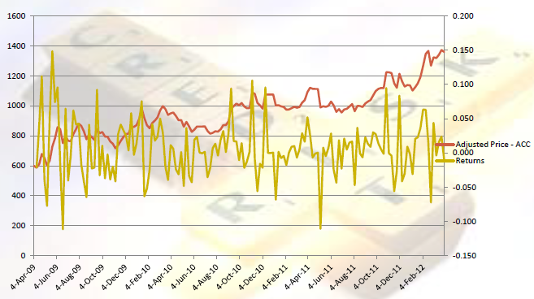
Step 1 and 2: ACC

Slide 12
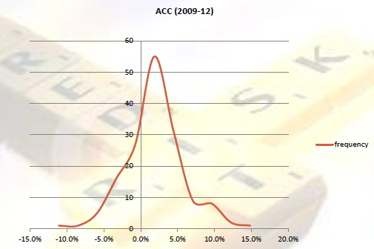
Step 3: ACC

Slide 13
Step 4: ACC
Mean 0.61%
Stdev 4%
COV 670.9%

Slide 14
Step 5: ACC
M Returns with 99% Prob -9% 546,459
Value at Risk (Normal Method) 56,939
M Returns with worst 1% Actual
Dist -11% 533,405
Value at Risk (Dist Method) 69,993

Slide 15
Game -Portfolio
Step 1: Choose any 8-10 Stocks
Step 2: Compute Steps 2-4
Step 3: Compute the Portfolio Mean, Standard Deviation etc.
Step4: Compute VaR(99%) using Parametric Method & Historical Simulation
Step 5: Validate your results using third year data

Slide 16
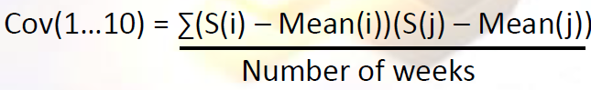
How to calculate
Mean/Variance of the portfolio
Let W = [ w1, w2, w3……..w10] – weights invested in 10 Stocks
Mean of the portfolio = Σ w(i)Mean(i), where i= 1…10
Variance of the portfolio = W(i)’Cov(1…10)W(i)

Slide 17
Game : Does Mean-Variance
Approach Work for India Market?
Step1: Start with the Same Portfolio from Game Four.
Step2: Make a Note the Mean, Variance and VaRof the Portfolio*
Step3: Determine the Portfolio Weight Assuming Mean-Variance Theorem of Markowitz
Step4: Compute and Compare the VaRof this Portfolio to Portfolio from Game 4.
Step5: What do you Infer?

